Slide 1
Health Care Monitoring System with a Comprehensive Dashboard
Deep Patel, Paritosh Gandre, Farook Ahmed Ali Shaik, Yash Kheni

Slide 2
Presentation Outline
Motivation
Research Questions & Goals
System Architecture
Data Collection & Preprocessing
Exploratory Data Analysis & Feature Selection
Predictive Modeling & Validation
Dashboard & Visualizations
Key Results & Insights
Limitations & Scalability
Conclusion & Acknowledgements
Yash Kheni

Slide 3
Motivation
Heart disease and diabetes are leading causes of mortality worldwide.
Early detection is crucial to improve health outcomes.
Many cases remain undiagnosed until severe complications arise.
Our system provides automated ML-based health monitoring and real-time alerts.
A centralized dashboard improves doctor–patient interaction and enables preventive care to reduce hospital readmissions.
Yash Kheni

Slide 4
Research Questions & Goals
Key Research Questions:
Can ML models accurately predict heart disease and diabetes?
What factors (e.g., blood pressure, glucose, BMI) are most predictive?
How does real-time risk assessment compare to traditional methods?
Can the system improve doctor–patient engagement and enable timely interventions?
System Goals:
Provide real-time alerts for critical health thresholds
Enable early disease detection using ML
Enhance doctor–patient interaction through a dashboard
Yash Kheni

Slide 5
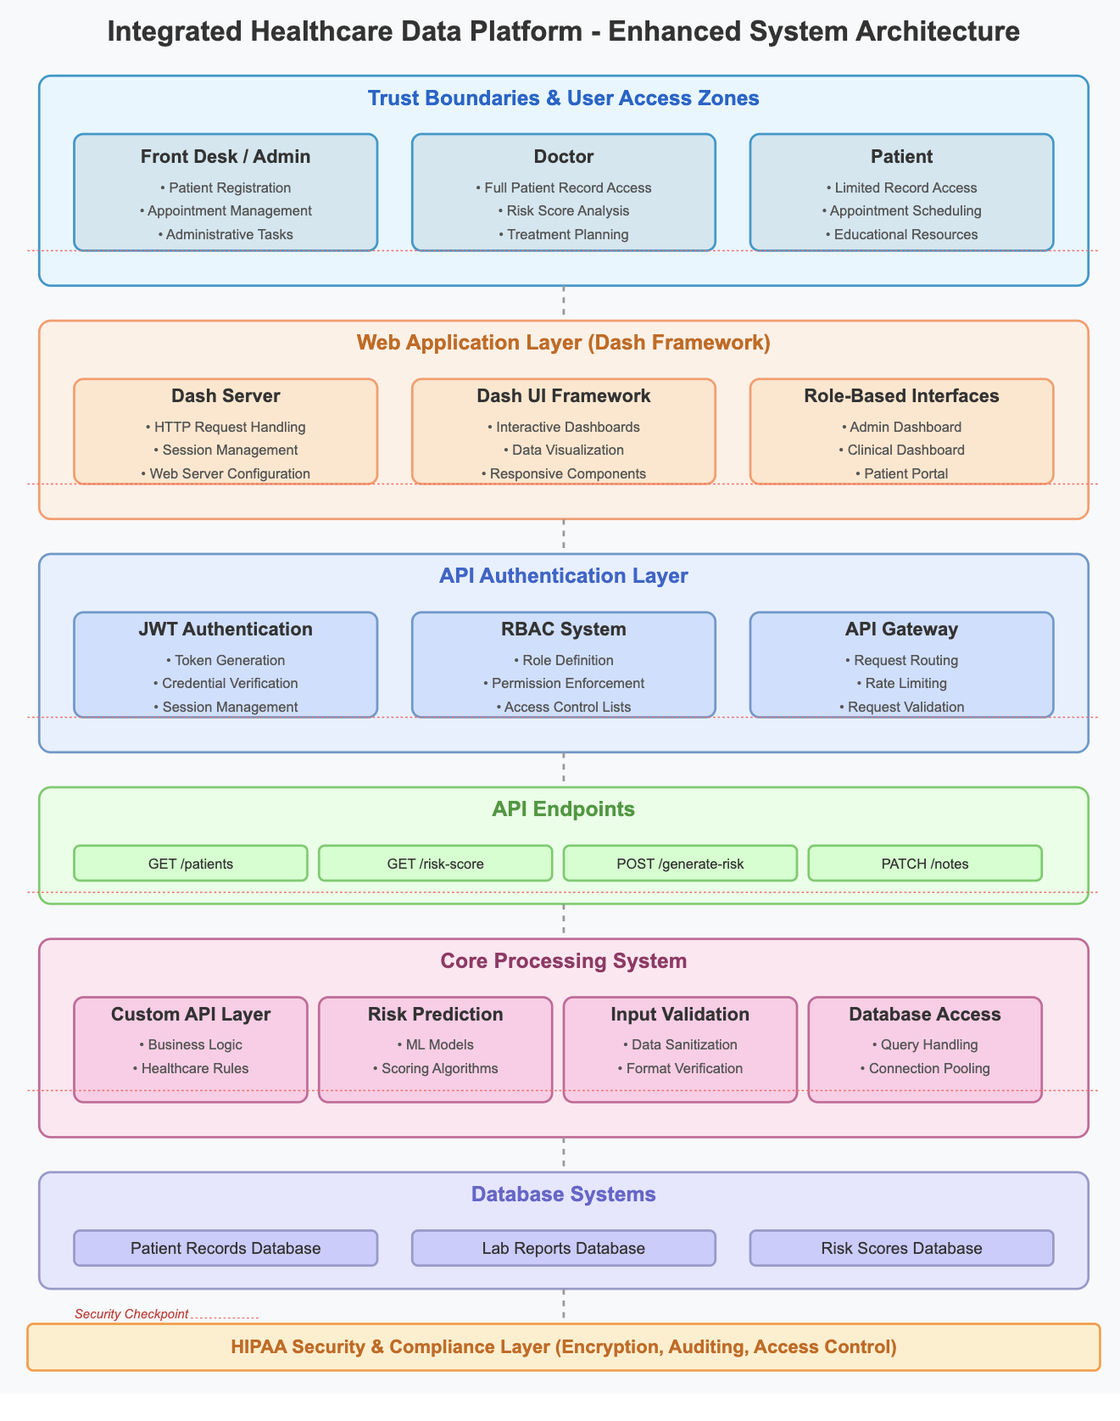

Slide 6
Database Schema Details
Schema Design:
5 normalized tables:
Patients
Users (Doctors & Admin Staff)
Appointments
LabReports
RiskScores
Concurrency & Performance:
Our system can handle around 20,000 request concurrently.
Yash Kheni

Slide 7
Backend API Details
Technology Stack:
Built with Python, FastAPI, and Uvicorn
API routes in backend.py (can be modularized later)
Middleware & Validation:
CORS enabled for frontend access
Uses type annotations, try/except for error handling
Future Scalability:
Currently synchronous with SQLite
Can upgrade to async I/O and full RDBMS for better performance
Yash Kheni

Slide 8
Data Collection & Generation
Relational Data Model:
SQLite schema with five tables:
Patients, Appointments, LabReports, Vitals, RiskScores
Links demographics → visit history → vitals → risk assessments
Synthetic Data Generation:
Python script (data_generator.py) using Faker
Simulates:
Patient demographics (age 20–85)
Multiple visits per patient with vitals & lab values
Custom functions to compute heart & diabetes risk scores at each visit
Data Quality:
Missing values kept minimal; real‐world nulls would be imputed or dropped
FAROOK AHMED ALI SHAIK

Slide 9
Features
Heart Disease
Diabetes
Age
Systolic
diastolic(blood pressure)
Heart Rate
BMI
Cholestrol
Age
Glucose
BMI
Hemoglobin
FAROOK AHMED ALI SHAIK

Slide 10
Data Preprocessing & EDA
Blood Pressure Parsing:
Split blood_pressure (“sys/dia”) into numeric systolic & diastolic
Train/Test Split
80 / 20 split (random_state=42) for reproducibility
Statistical Summaries:
Age: Most patients fall between 34 and 70 years
Overall range from 20–85
Correlation:
Age vs. heart/diabetes risk: moderate positive relationship (~0.6)
FAROOK AHMED ALI SHAIK

Slide 11
Key Data Insights (EDA)
Demographics:
Age: uniform 20–85 years (mean ≈ 52)
Gender: 50 % male / 50 % female
Risk Scores:
Heart & diabetes risk (0–1): roughly bell-shaped
Means: heart ≈ 0.45, diabetes ≈ 0.50
Majority low-to-moderate risk, with higher-risk tail
Overall Insight
Synthetic data mimic realistic patterns, ready for modeling and dashboarding
FAROOK AHMED ALI SHAIK

Slide 12
Dashboard Overview
Doctors → Risk evaluation & clinical summary
‍Front Desk → Patient flow & appointments
‍️Nurse → Lab reports, vitals, scheduling
Patients → Health records, risk trends, messaging
Deep Patel

Slide 13
Doctor Dashboard
Purpose: Enables clinicians to select a patient and view personalized health metrics.
View patient-specific risk scores (heart, diabetes)
Analyze risk trends over time
See patient profile, vitals, and visit info
Deep Patel

Slide 14
Front-Desk Dashboard
Purpose: Provides administrative staff with high-level operational metrics.
Real-time active patient count
Track appointments, age demographics
View monthly risk trends, lab report activity
Deep Patel

Slide 15
Nurse Dashboard
Purpose: Allows drill-down into an individual patient’s risk trajectory.
Monitor active patients
Access lab results & risk scores per patient
Review appointments and vitals data
Filter data using dropdowns and tabs
Deep Patel

Slide 16
Patient Dashboard
Purpose: Empowers patients with a self-service interface to view their health records.
Access personal health records & medications
View lab results & risk score history
Use education tools, goal tracker, and messaging
Maintain a symptom journal and see upcoming appointments
Deep Patel

Slide 17
Modeling Approach
Algorithms Evaluated: Four regression models were trained to predict each risk score: Linear Regression, Random Forest (100 trees), Gradient Boosting (100 estimators), and XGBoost (100 estimators). This covers both linear and tree-based approaches.
Pipeline: The train_predictive_model.py script performs SQL data extraction (joining vitals, patients, risk), preprocessing, feature engineering (including BP parsing), model training, and evaluation.
Metrics: Models are evaluated on test data using R² (coefficient of determination) and RMSE (root mean square error). The model with highest R² is selected as final.
Model Persistence: The best models for each task are saved as serialized .pkl files (via joblib.dump). These can be loaded by the Dash apps at runtime to score new inputs if needed.
Cross-Validation: A single train/test split is used due to resource limits; future work could incorporate k-fold or nested CV to better estimate performance.
PARITOSH GANDRE

Slide 18
Model Performance Results
Heart Disease Risk Prediction: Linear Regression performed best with test R² ≈ 0.4793 and RMSE ≈ 0.0404. Other models achieved similar R² (~0.46–0.48) except Random Forest (R² ≈ 0.3024)
Diabetes Risk Prediction: Linear Regression again led with R² ≈ 0.1223 and RMSE ≈ 0.1240 Gradient Boosting was very close (R² ≈ 0.1217, RMSE ≈ 0.1240); XGBoost and Random Forest underperformed (R² ≈ 0.0973 and –0.1759, respectively)
Summary: Table 1 (in the report) compares all model metrics. Linear Regression’s consistently highest R² made it the final choice for both prediction tasks. These results indicate modest predictive capability on the synthetic data, with room for improvement via tuning and richer features
PARITOSH GANDRE

Slide 19
Limitations
Synthetic Data Bias: The dataset is entirely synthetic (Faker-generated) with simplified risk formulas.. This ensures privacy and speed but lacks real-world complexity: patient diversity (comorbidities, socio-economic factors) is limited, and risk is a linear combination of vitals rather than multi-factorial as in true clinical scoring
Sample Size Constraints: With ~10,000 patients (50k records), the dataset suffices for demonstration but is orders of magnitude smaller than real-world needs. Rare events or subgroup patterns (e.g., specific age-gender interactions) may not be captured. Temporal dynamics (seasonal disease trends) are also simplified.
PARITOSH GANDRE

Slide 20
Future Work: Data & Models
Real-World Data Integration: Incorporate de-identified EHR datasets (e.g., MIMIC-IV) to improve realism and heterogeneity. Multi-center data could capture geographic/institutional variability.
Advanced Synthetic Data: Use generative models (GANs, VAEs) for higher-fidelity synthetic records that better emulate true vitals distributions and correlations. Data augmentation (e.g., SMOTE) could balance underrepresented high-risk cases.
Algorithm Extensions: Explore deep learning architectures (RNNs or temporal CNNs for time-series vitals) and multi-modal models (integrating tabular data with images like ECGs using CNNs). Consider ensemble/meta-learning (stacking/blending) to combine model strengths
Optimization & Explainability: Implement automated hyperparameter tuning (e.g., Bayesian optimization with Optuna/Hyperopt) to improve performance. Incorporate explainability (feature importance, SHAP values) to make risk predictions more transparent to clinicians.
PARITOSH GANDRE

Slide 21
Scalability
Data: Real clinical records
Models: Integrate XGBoost & CNN for imaging data
Scope: Add hypertension, kidney disease, metabolic syndromes
Explainability: Implement SHAP/LIME for model interpretability
IoT Integration: Real‑time wearable/device data streams
Real‑Time Alerts & Messaging
Mechanism: WebSocket pushes to front‑end
Alert Types:
In‑dashboard notifications
Email / SMS for critical risk exceedances
User Flow: Immediate feedback → Early intervention
PARITOSH GANDRE

Slide 22
Conclusion
The presented system is a comprehensive, modular platform integrating synthetic data generation, a robust backend, ML-driven risk prediction, and interactive dashboards. It leverages SQLite (relational storage), FastAPI (APIs), and Dash (role-based UIs) to provide end-to-end functionality.
Real-Time Risk Assessment: Automated ingestion of vitals feeds predictive models that quantify heart and diabetes risk. Dashboards refresh metrics and trends continuously, ensuring clinicians and administrators receive timely alerts for early interventions
Best Practices: The project follows rigorous ML methodology (feature engineering, train/test split, R²/RMSE evaluation) and persists optimal models for deployment. Linear Regression emerged as the best predictor on our data (as reported in Section 7), though the architecture allows easy replacement with more advanced models.
Extensibility: Though initially using synthetic data, the design accommodates integration with real EHR streams, IoT devices, and advanced augmentation techniques. Security protocols (e.g., OAuth2, FHIR compliance) and authentication are planned for production readiness.
Impact: This prototype demonstrates how modern web frameworks, ML libraries, and visualization tools can converge to support preventive healthcare. Its scalable, maintainable architecture can incorporate additional disease modules and data sources. Ultimately, the system has potential to improve patient outcomes and resource utilization by enabling proactive, data-driven care
PARITOSH GANDRE

Slide 23
Acknowledgements & References
Acknowledgements: Prof. Samba Augustine
Key References:
Chen, A., & Chen, D. O. (2022). Simulation of a machine learning-enabled learning health system for risk prediction using synthetic patient data
Abhadiomhen, S. E., Nzeakor, E. O., & Oyibo, K.(2024) Health risk assessment using machine learning: Systematic review. Electronics
Singh, R., et al. (2024) Artificial intelligence for cardiovascular disease risk as- sessment in personalized framework: A scoping review
Kasula, B. Y. (2023) Machine Learning Applications in Diabetic Healthcare: A Comprehensive Analysis and Predictive Modeling
Liu, T., Krentz, A., Lu, L., & Curcin, V. (2024) ​Machine learning based predic- tion models for cardiovascular disease risk using electronic health records data: Systematic review and meta-analysis. European Heart Journal—Digital Health
PARITOSH GANDRE

Slide 24
Thank You

